Slide 1
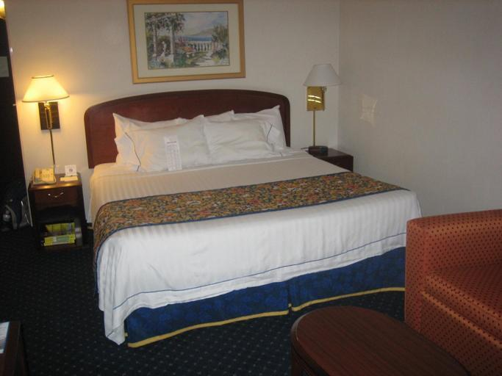
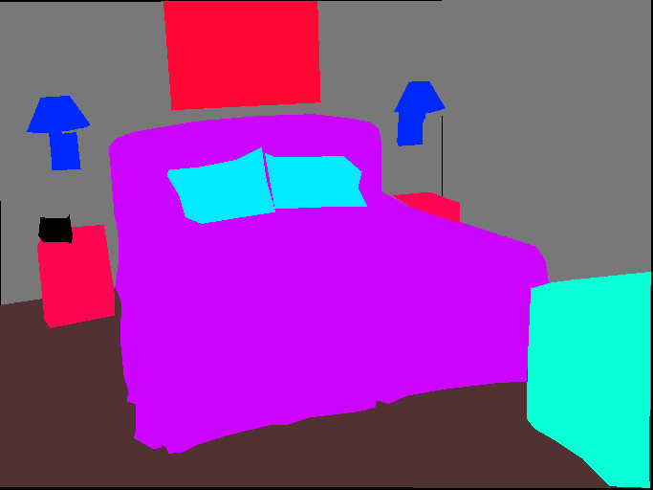
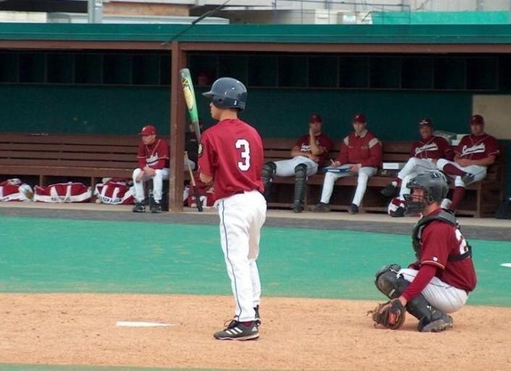
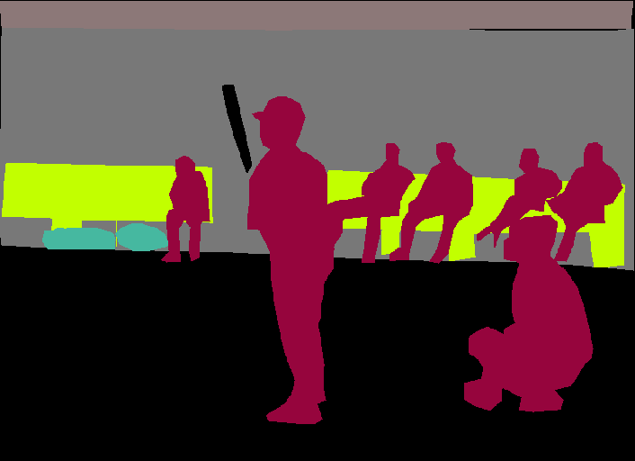
Baseline method
Dataset | Model architecture
ADE-20K | Encoder | Decoder
 | ResNet50 | UperNet
20K images for training, 20K images for validation
150 semantic categories
Stuffs: sky, road, grass …
Discrete objects: person, car, bed …

Slide 2
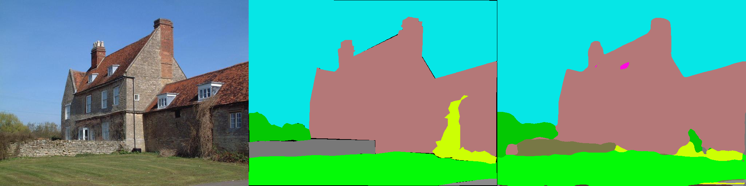
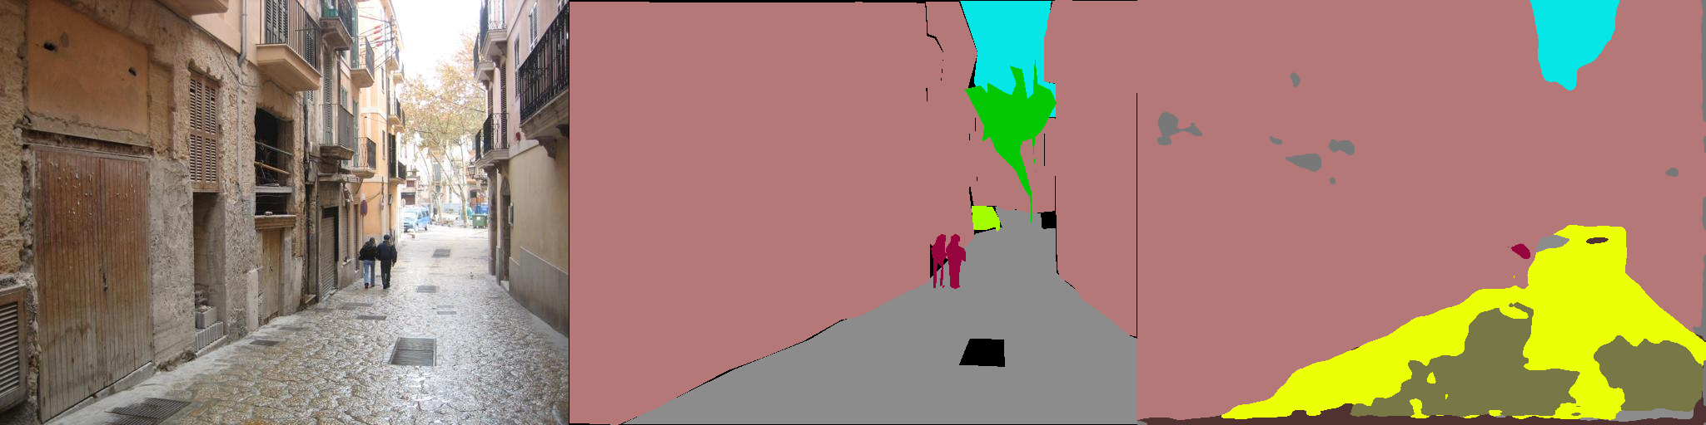
Baseline performance
Dataset | Model | Start Lr | vGPUs | Epoch | Training accuracy | Validation accuracy
ADE-20K | ResNet50-UperNet | 0.02 | 1 | 10 | 61.6 | 53.8
Original image
Annotation
Prediction

Slide 3
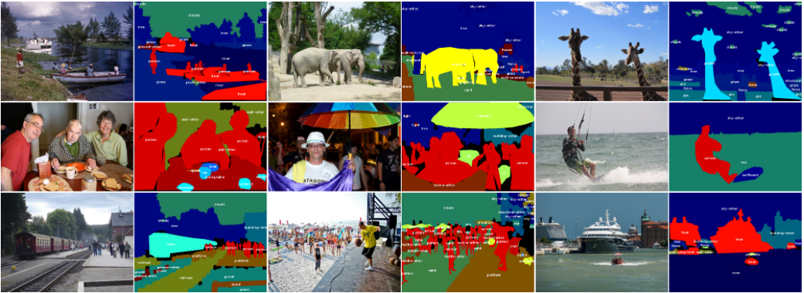
New dataset – Coco Stuff (Coco10K)
10K images for training, 1K images for validation.
91 thing classes and 91 stuff classes.
The smallest subset of the entire Coco-Stuff dataset

Slide 4
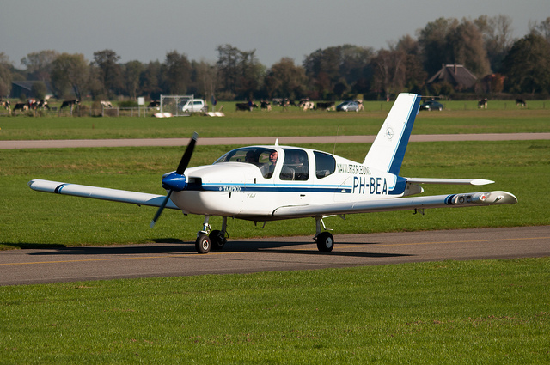
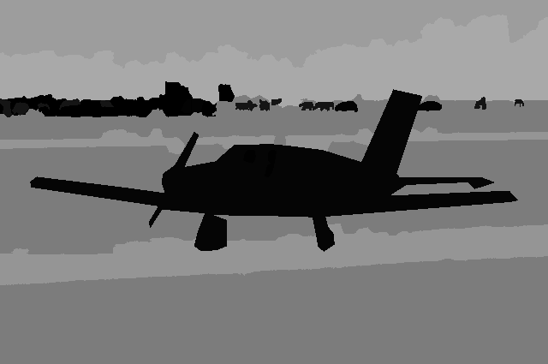
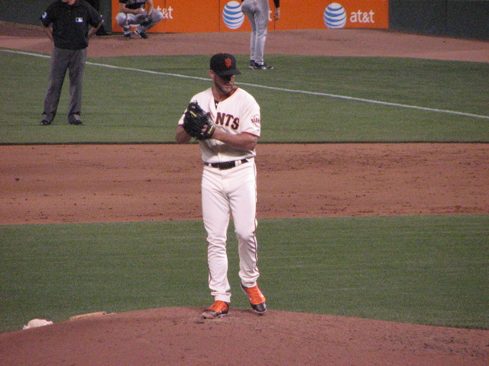
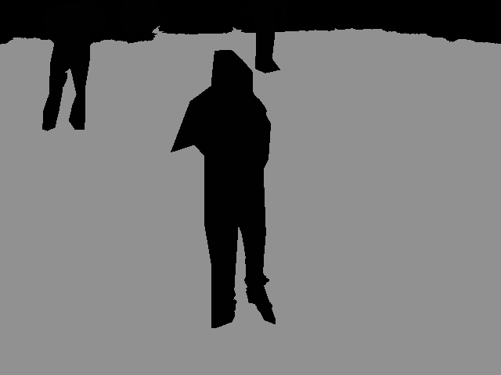
Apply the original model to the new dataset
Original image
Annotation

Slide 5
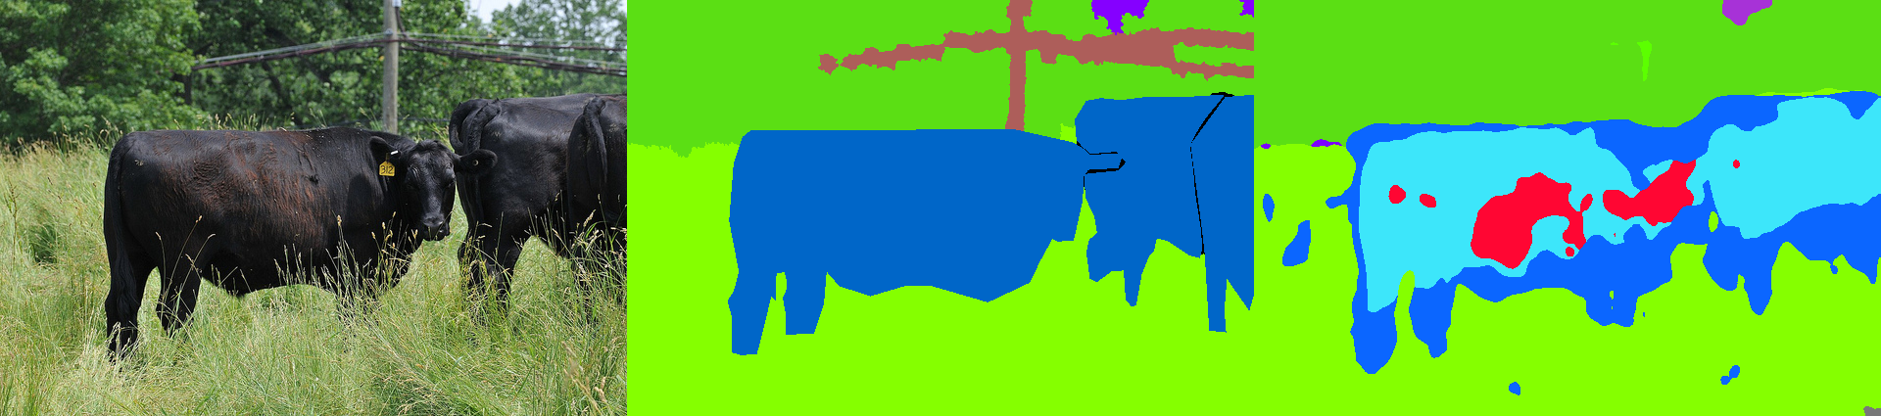
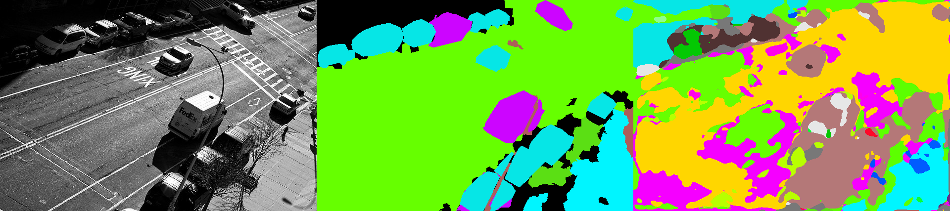
Performance of the new Dataset
Dataset | Model | Lr | Epoch | Training accuracy | Validation accuracy
Coco10K | ResNet101-Upernet | 0.02 | 10 | 57.1 | 49.4
Original image
Annotation
Prediction

Slide 6
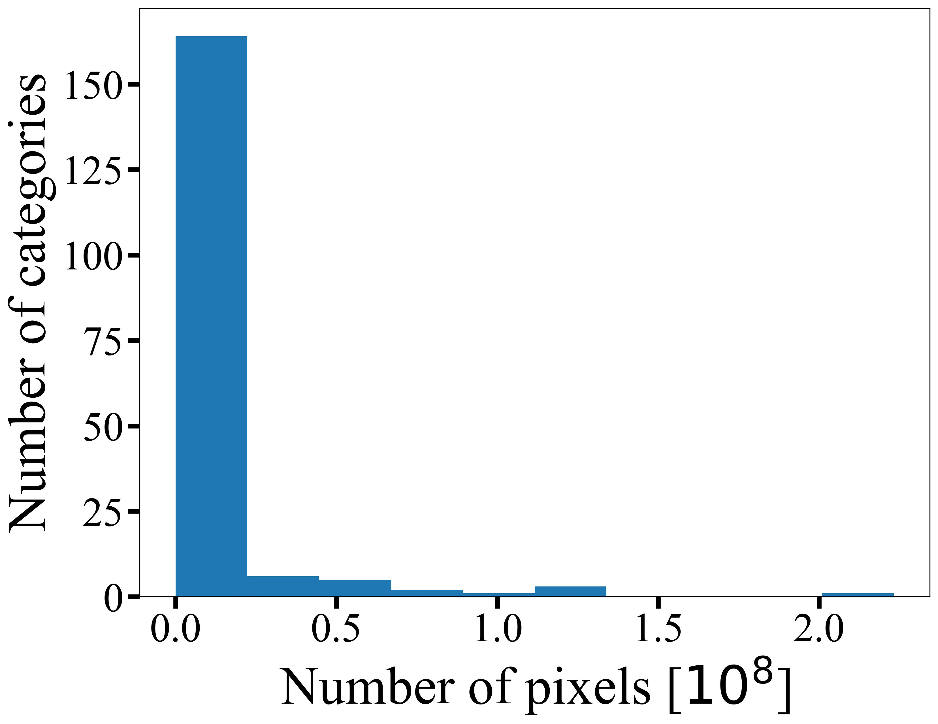
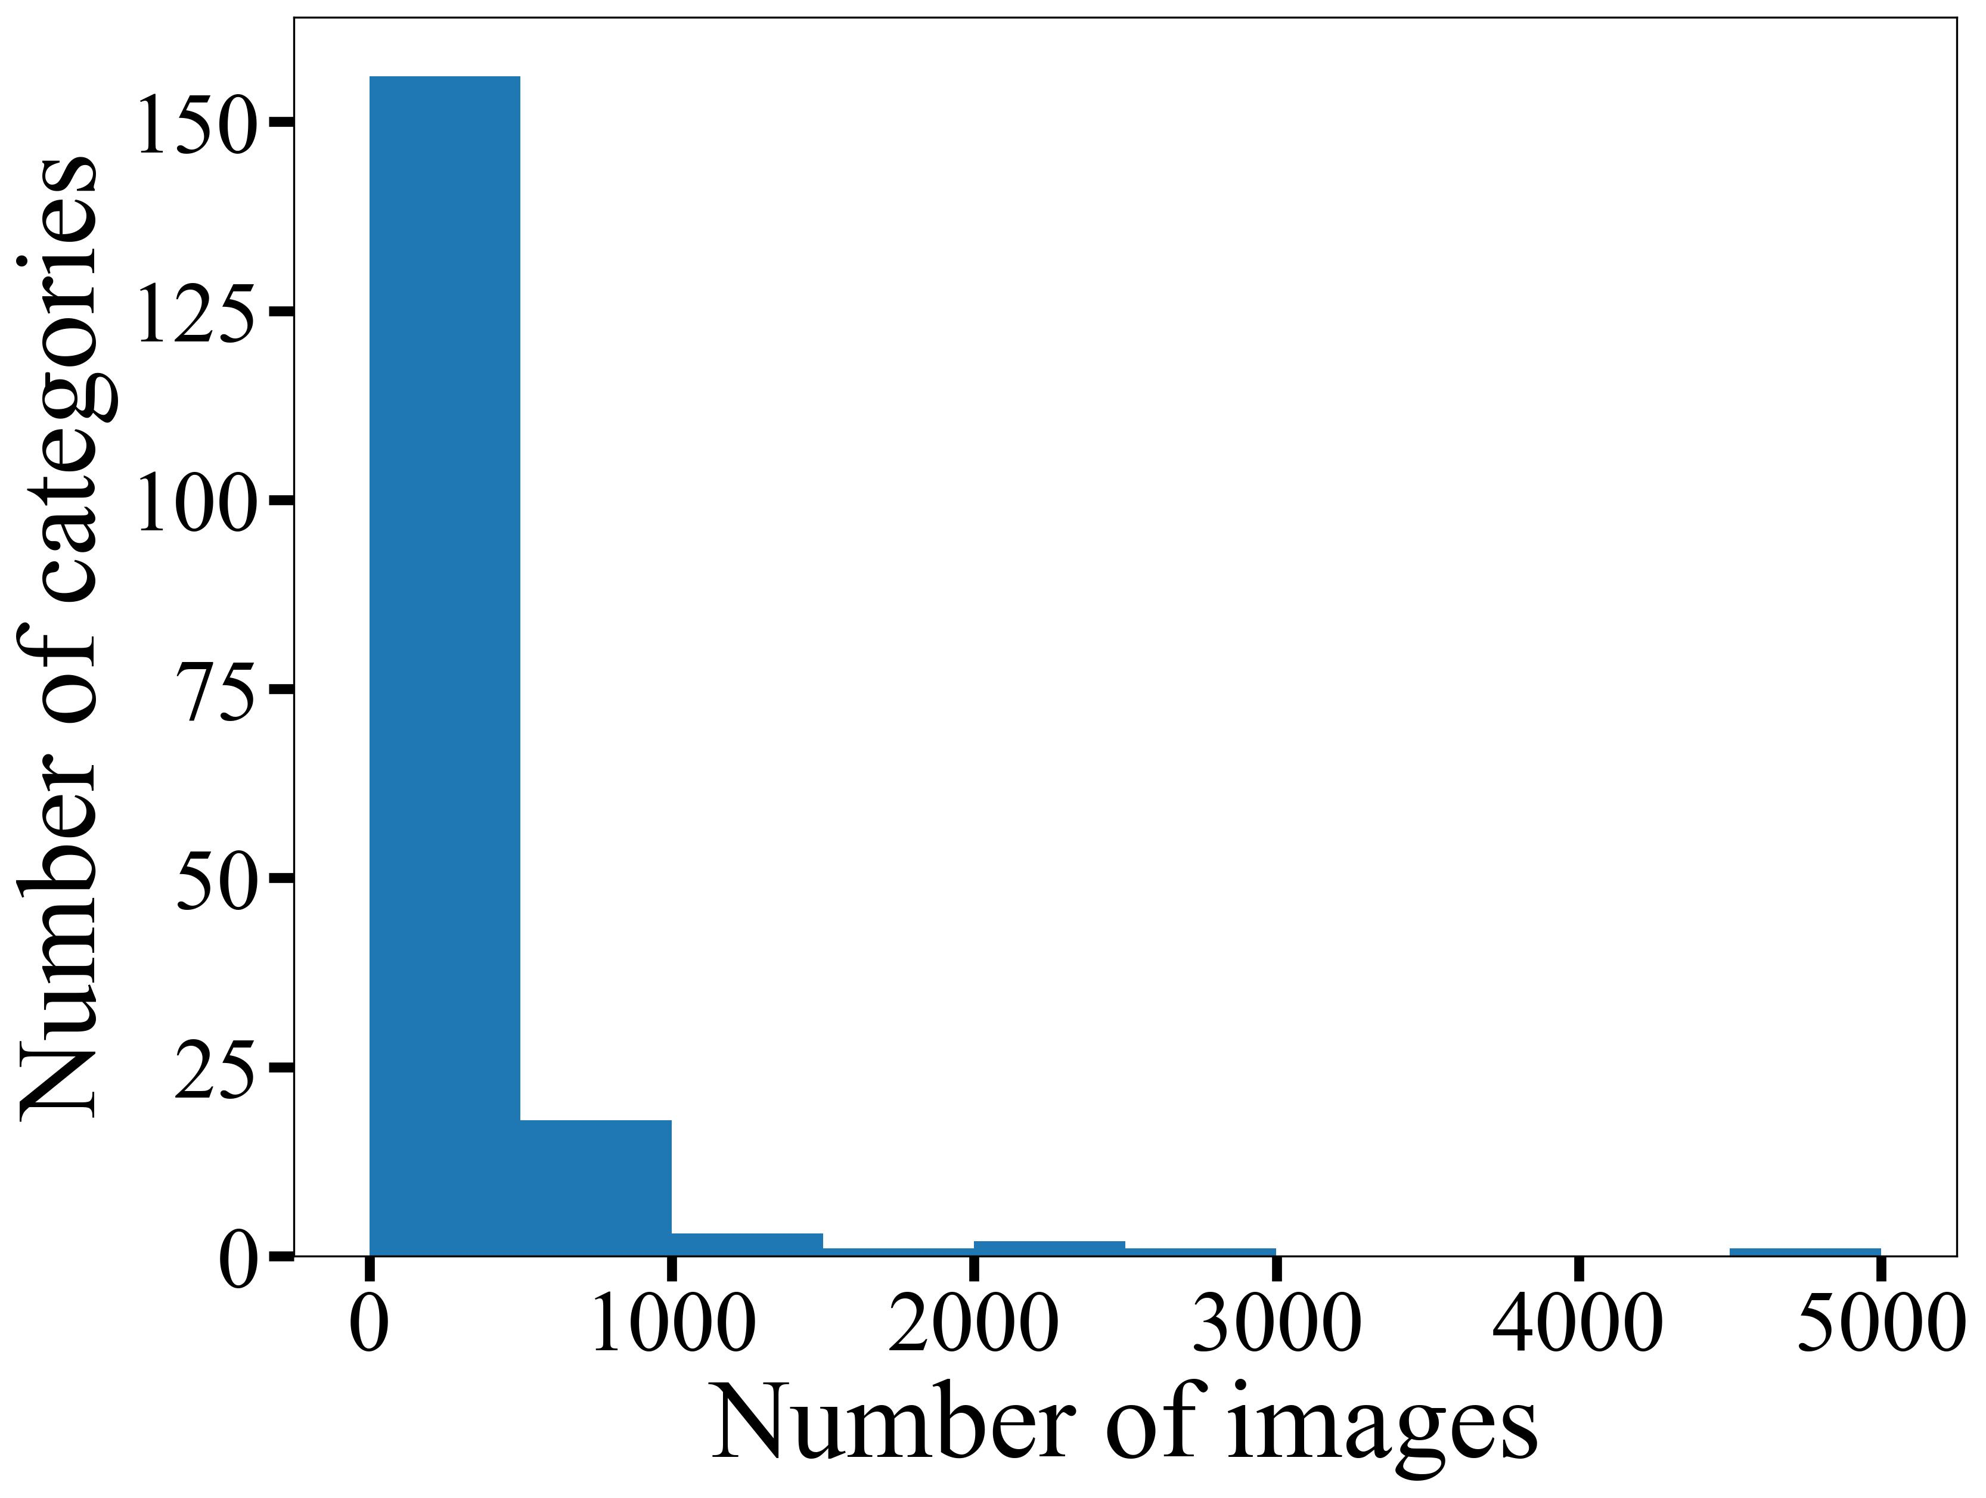
Why performance degrades with new dataset?

Slide 7
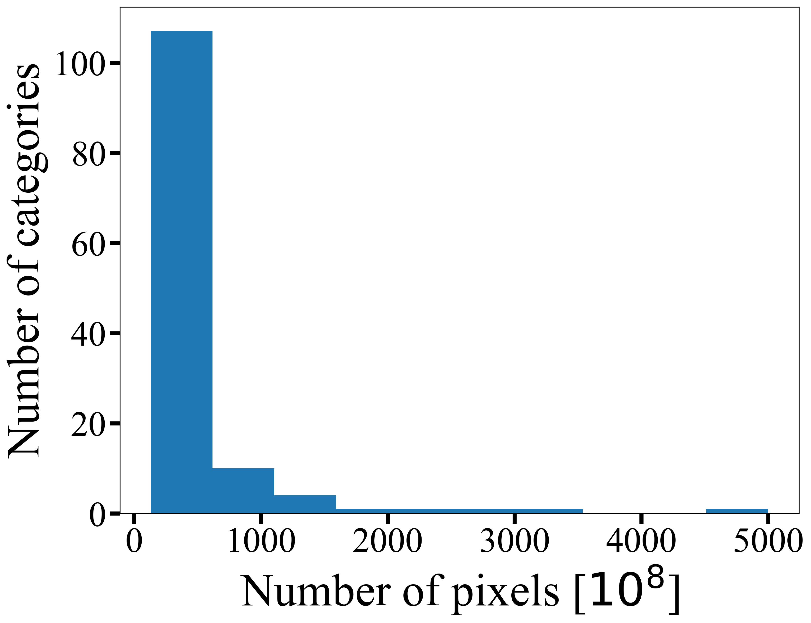
Improvement step 1 – combine categories

Slide 8
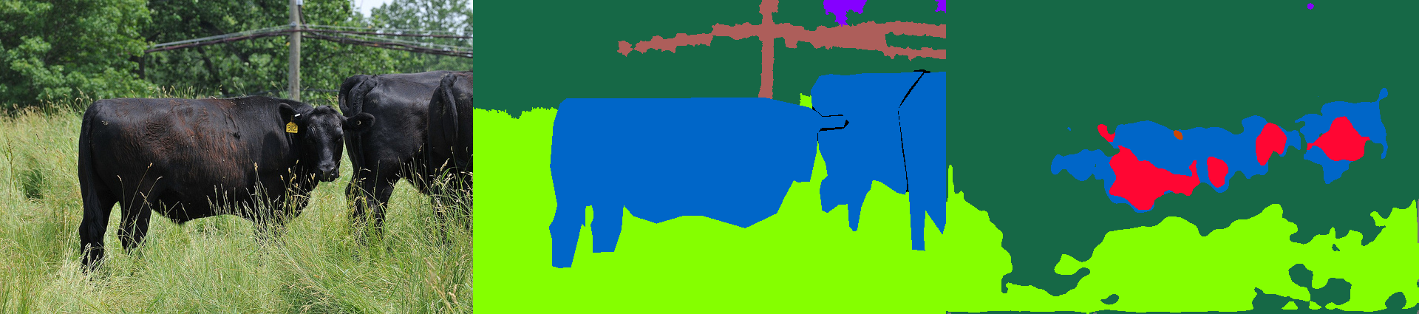
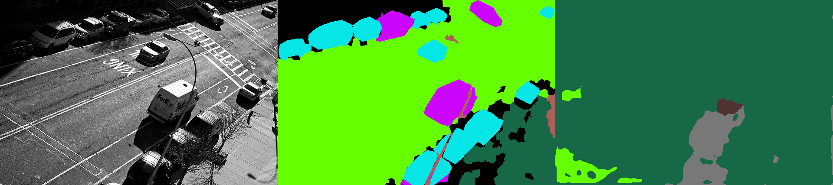
How much improvement do we get
Dataset | Model | Lr | Epoch | Training accuracy | Validation accuracy
Coco10K | ResNet101-Upernet | 0.02 | 10 | 57.1$→$59.7 | 49.4$→$52.4
Original image
Annotation
Prediction

Slide 9
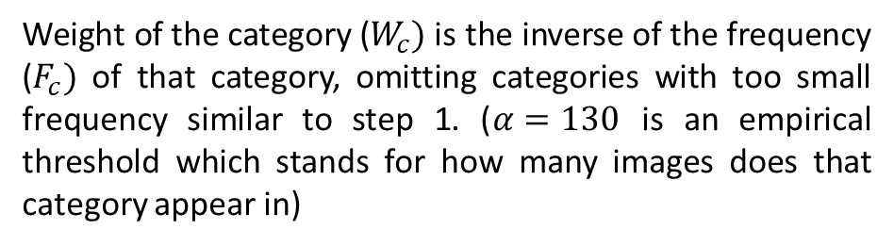
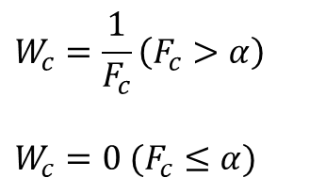
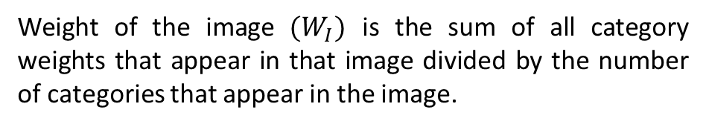
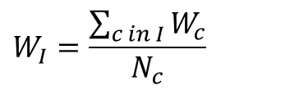
Improvement step 2 – applying different weights to images
$$W_{c}=\frac{1}{F_{c}}\left(F_{c}>α\right)$$
$$W_{c}=0 (F_{c}≤α)$$
Weight of the category ($W_{c})$ is the inverse of the frequency ($F_{c})$ of that category, omitting categories with too small frequency similar to step 1. ($α=130$ is an empirical threshold which stands for how many images does that category appear in)
$$W_{I}=\frac{\sum_{c in I}{W_{c}}}{N_{c}}$$
Weight of the image $(W_{I})$ is the sum of all category weights that appear in that image divided by the number of categories that appear in the image.

Slide 10
How much improvement do we get
Dataset | Model | Lr | Epoch | Training accuracy | Validation accuracy
Coco10K | ResNet101-Upernet | 0.02 | 10 | 59.7$→$xx.x | 52.4$→$xx.x
Original image
Annotation
Prediction

Slide 11
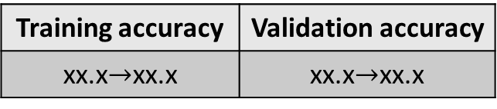
Conclusion
Applying original model to the new dataset, 3 steps to make improvement:
Combine very low frequency categories.
Assign different weights to images.
Use pretrained model from original dataset.
Final improvement
Training accuracy | Validation accuracy
xx.x$→$xx.x | xx.x$→$xx.x

Slide 12
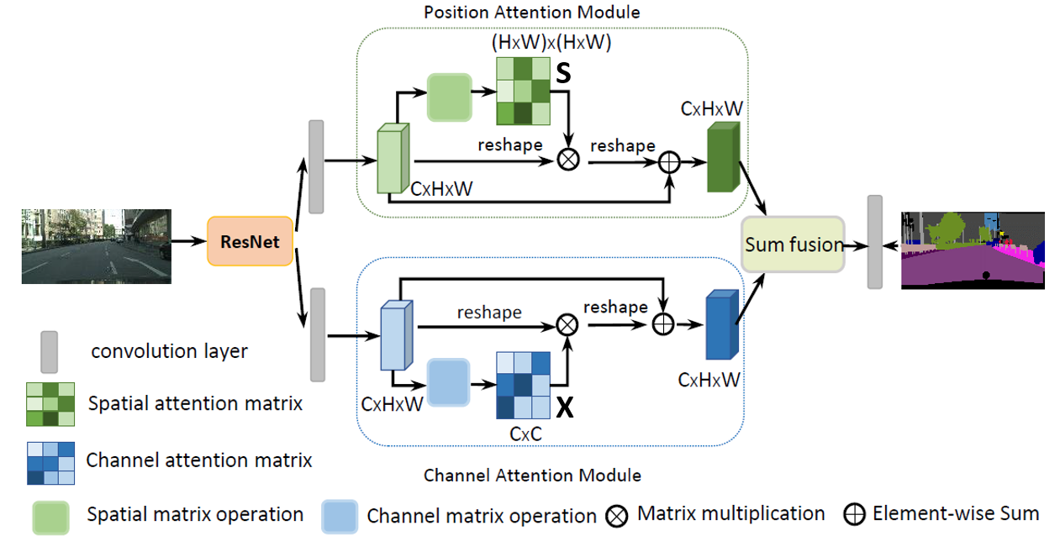
New decoder – Dual Attention Network (DANet)
Different from UPerNet that improves performance by fusing multi-scale features, DANet utilizes the inter-spatial relationship o features and applies attention modules before final prediction.
https://arxiv.org/abs/1809.02983
Notes:
In this part, I adopt a new decoder for image segmentation. I choose this decoder because it approaches this same problem from a different aspect. Instead of fusing multi-scale features, DANet utilizes attention mechanisms for final prediction. And this is the structure of danet, one position attention module and one channel attention module are applied to the feature map extracted by the encoder. We implement this model based on pytorch.

Slide 13
UPerNet vs DANet
Dataset | Model | Lr | Epoch | Training accuracy | Validation accuracy | Validation IOU
Ade20k | ResNet50dilated-DANet | 0.02 | 20 | 67.39 | 63.04 | 0.1191
Ade20k | ResNet50dilated-UperNet | 0.02 | 20 | 68.30 | 63.52 | 0.1213
Before we go into the details, we have to know that the models are poorly trained due to limited computational resource:
It is suggested by some similar studies that the training epoch should be 40 with at least 4 gpus.
The averaging IOU is low because some classes are poorly trained. IOU for those class is nearly 0, which makes the overall averaging IOU low.
One experiment with 4 gpus:
Dataset | Model | Lr | Epoch | Training accuracy | Validation accuracy | Validation averaging IOU
Ade20k | ResNet50dilated-DANet with 4-gpu | 0.02 | 10 | 82.32 | 72.44 | 0.2545
Notes:
Before I go into the details, I have to reiterate that our model are poorly trained due to limited computational resource. As suggested by the previous study, the optimal setup to train the UPerNet is to train with 4 gpu and train for 40 epochs, . However, we don’t have unlimited access to 4 gpu. Therefore, we cannot directly compare the performance of these two networks from the pixel-wise accuracy and IOU.
We also train with 4 gpus for only 10 epoch, the performance turns out to be much better than using only 1 gpu.
Before I go into the details, I have to reiterate that our model are poorly trained due to limited computational resource. Therefore, we cannot directly compare the performance of these two networks from the pixel-wise accuracy and IOU, but we can perform the analysis based on some examples.

Slide 14
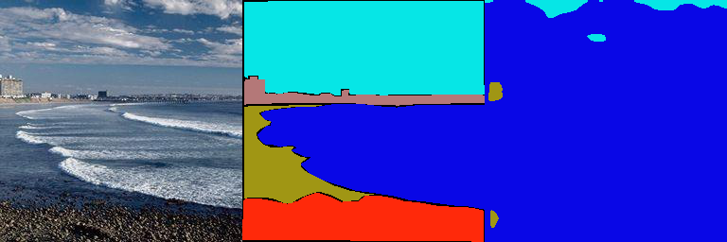
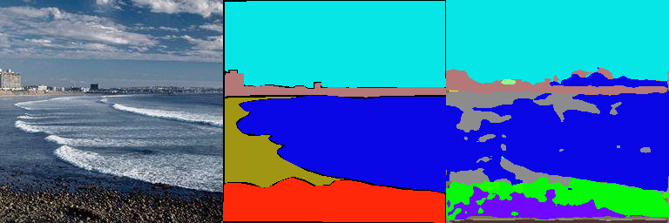
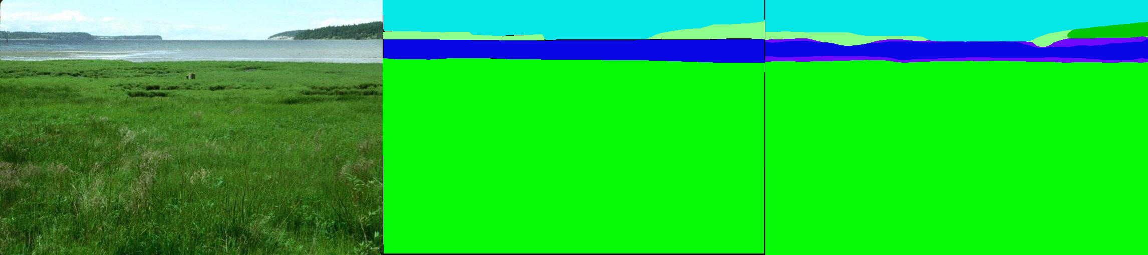
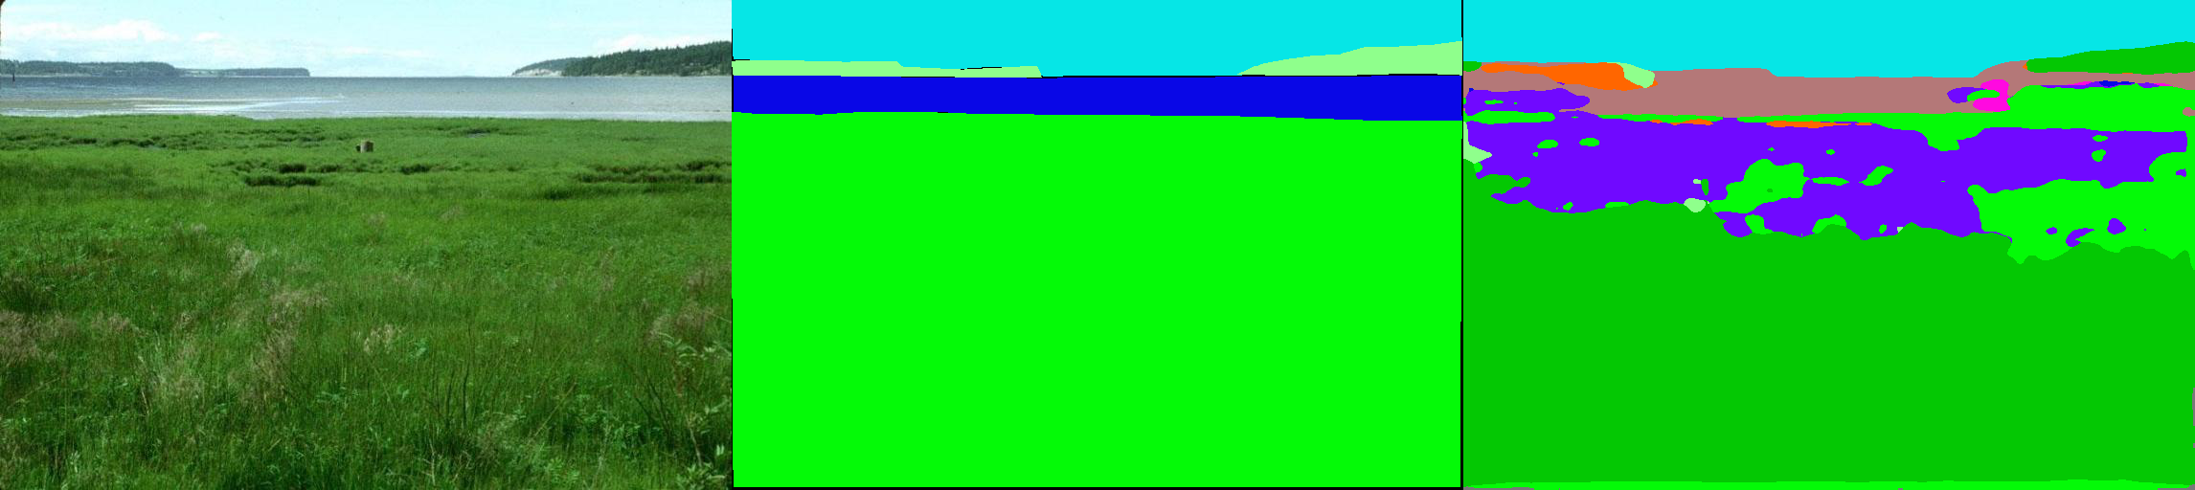
UPerNet vs DANet
Image Ground Truth DANet UPerNet
UPerNet is better
DANet is better
UPerNet can better capture detailed features compared to DANet
DANet is more likely to classify similar pixels into the same category and avoid deceiving by unimportant details due to attention module.
Notes:
Here are two predictions example for UperNET and DAnET. UperNet can better capture details in the image compareD to DANet. For example, there are buildings in the image, but there are far away and relatively small. UPerNet correctly capture it while danet does not. In contrast, DANet is more likely to classify similar pixels into the same category through attention mechanisms, and avoid deceiving by unimportant details. For example, DANet does a good job in segmenting this grass land, while UperNet predicts some mess here.

Slide 15
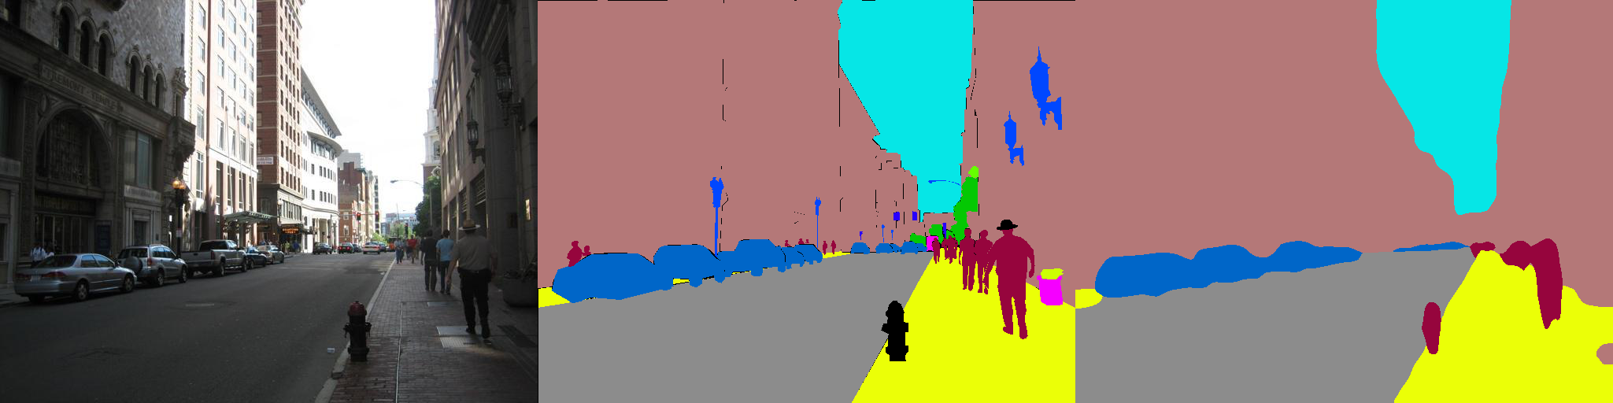
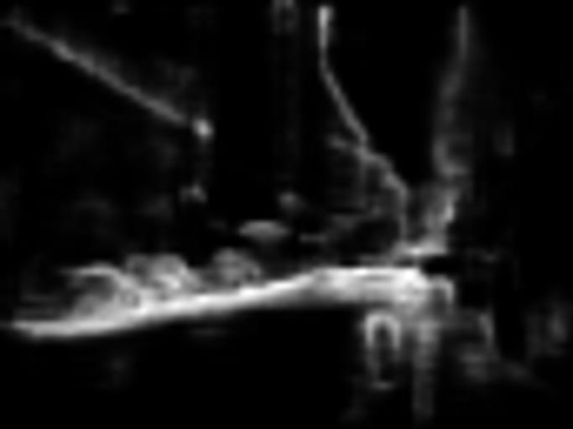
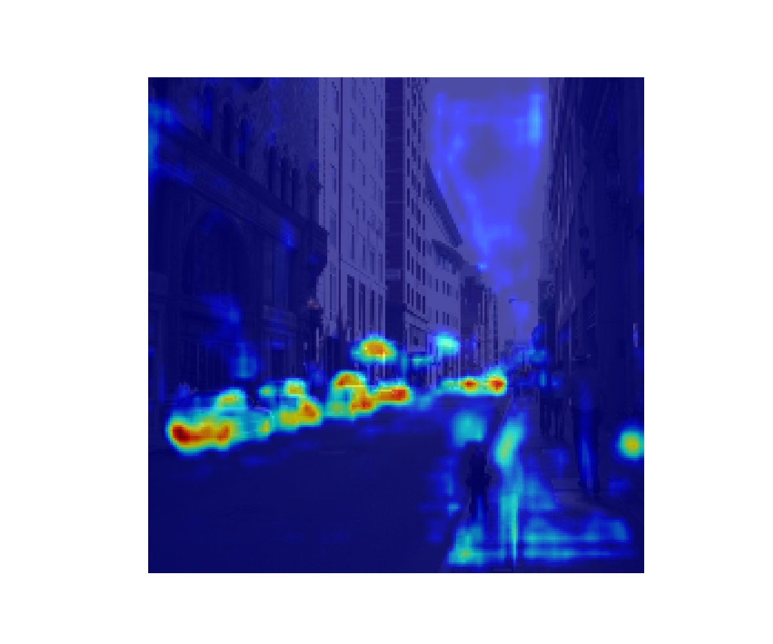
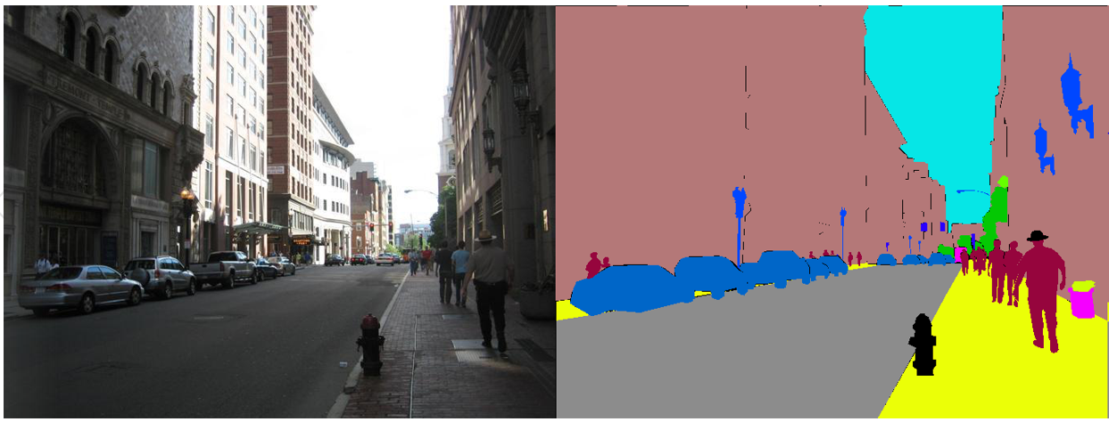
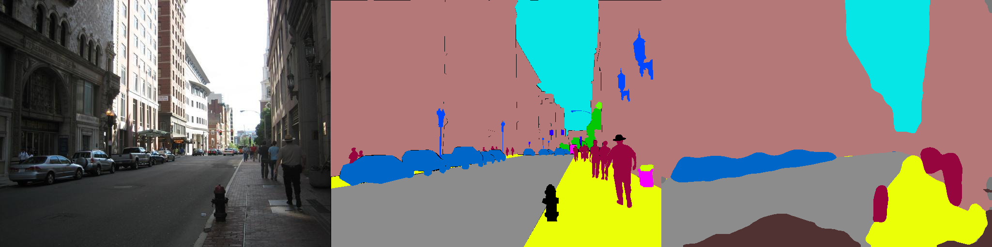
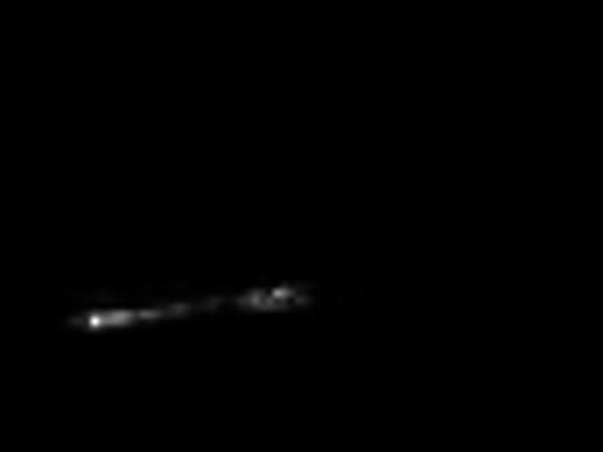
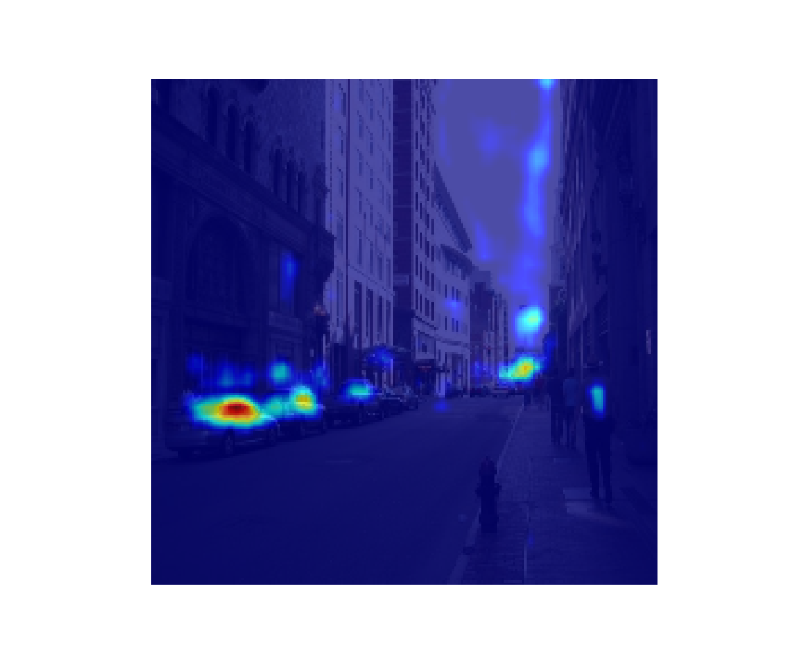
Ablation study for DANet: are attention modules effective with limited training epochs?
Dataset | Model | Lr | Epoch | Training accuracy | Validation accuracy | Validation IOU
Ade20k | ResNet50dilated-DANet | 0.02 | 20 | 67.39 | 63.04 | 0.1191
Ade20k | ResNet50dilated-DANet w/o attention modules | 0.02 | 20 | 68.68 | 60.30 | 0.1034
Attention map
Attention map
Notes:
Because the model is not well trained, I will demonstrate the attention modules are still effective. I do this the ablation study on danet.. I pick a point plot the attention map using different models and the original DANet shows a much better attention than the other.
It seems that the original DANet has no obvious advantage in pixel wise acc and IOU, but again this can be due to the training condition. I plot the positional attention map for a point on a car in this image. It can be seen that the attention for a point on the car makes more sense than the attention map in the bottom where attention modules are not trained. The last two plots are the channel attention. The attention on car category is enhanced after applying channel attention module.
We also demonstrate the attention modules are effective even with limited training by ablation study. That means I remove the attention modules but retain the other convolutional layers in the decoder during the training and compare the results. For time reason I will skip them here.

Slide 16
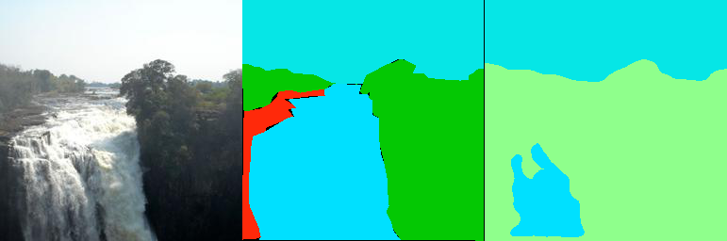
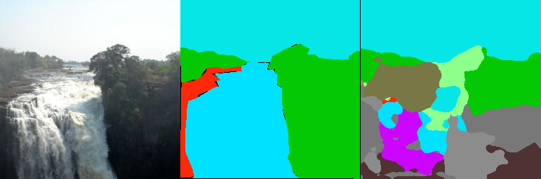
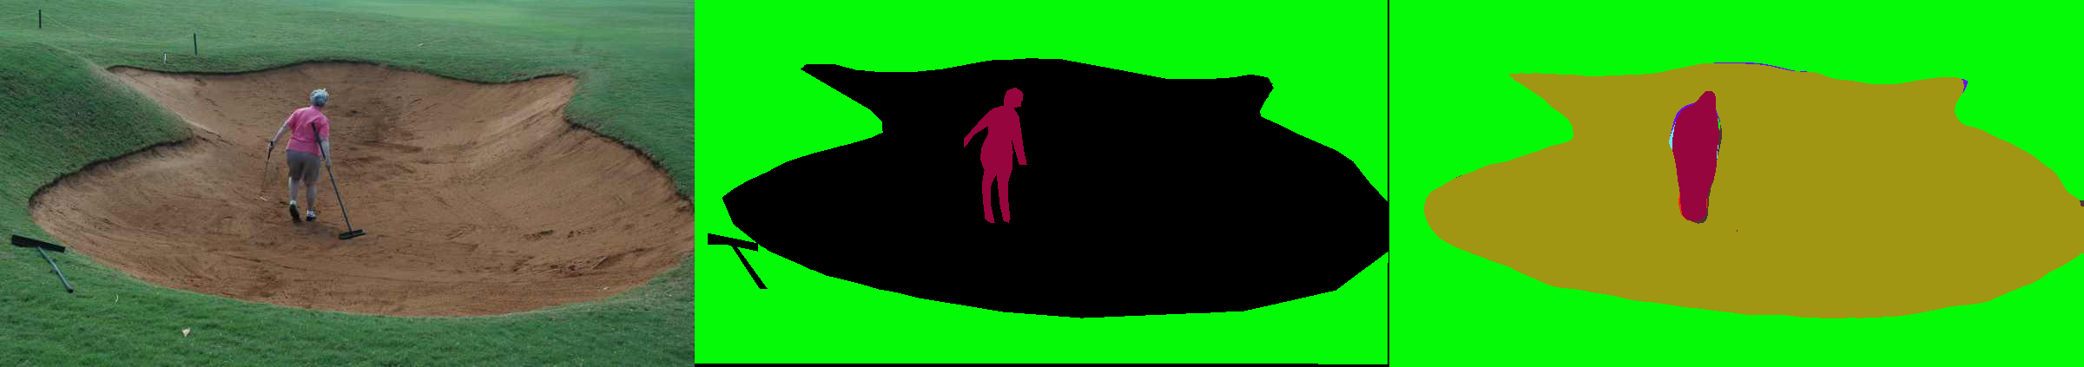
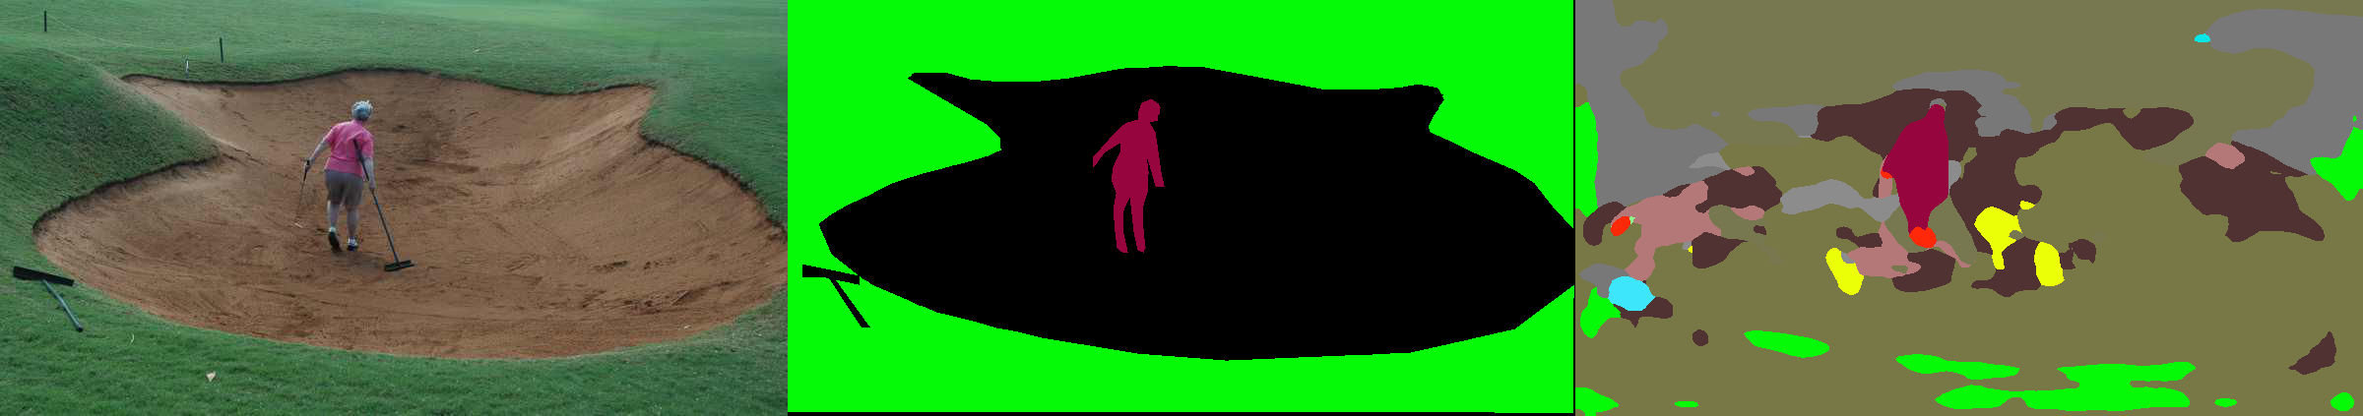

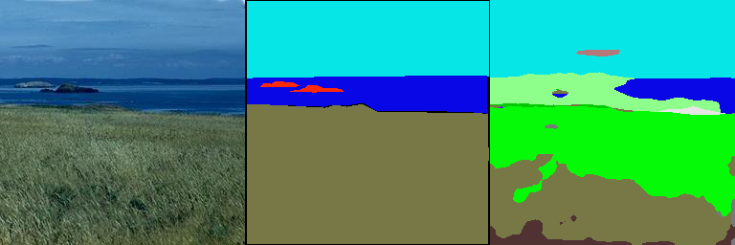
Ablation study for DANet: are attention modules effective with limited training epochs?
Image Ground Truth DANet DANet w/o attention
Even though DANet cannot segment the image with correct classification with limited training, it predict good segment boundaries.
Notes:
Here are more results for the ablation study. Even though danet without attention modules achieve even higher pixel-wise accuracy, it fails to take the advantage of danet and predict these little fragments. In contrast, even though DANet cannot segment the image with correct classification with limited training, it predict good segment boundaries.
I also compare some examples, Even though DANet cannot segment the image with correct classification with limited training, it predict good segment boundaries. So the attention module is indeed effective even if the model is not well trained.

Slide 17
Conclusions
For DANet:
Even though our model is poorly trained, the attention modules are proved to be effective
Compared with UPerNet:
We are not able to compare which network can achieve better performance due to limited computing resource.
DANet is relatively good for big scenes where details are relatively not important.
UPerNet is relatively good for scenes where different features are at different scales.
Notes:
In conclusion, the attention modules in DaNet is proved to be effective even if the overall model is not well trained. Compared with UPerNet, DANet is relatively good for big scenes where details are relatively not important, and UPerNet is relatively good for scenes where different features are at different scales.

Slide 18
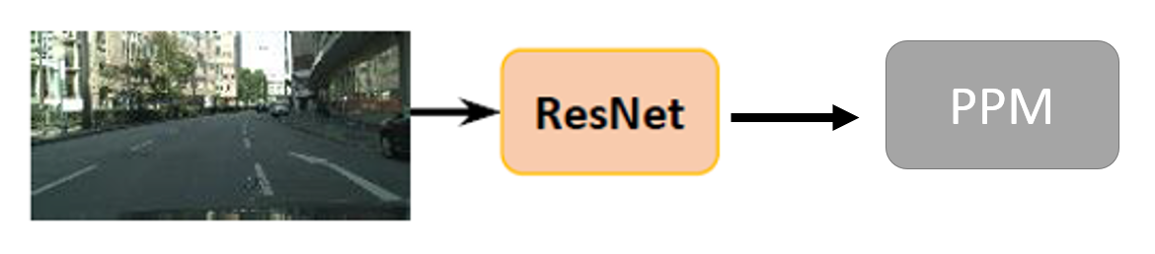
New decoder – PPM-DANet
Notes:
The last part of our work is that we propose a new decoder network. Inspired by the advantages of UperNet that fuses multi-scale features and the advantages of danet that uses attention modules, we add a pyramid pooling module before feeding the feature map into the attention modules, and we called it PPM-Danet.

Slide 19
New decoder – PPM-DANet
Dataset | Model | Lr | Epoch | Training accuracy | Validation accuracy | Validation averaging IOU
Ade20k | ResNet50dilated-DANet with 4-gpus | 0.02 | 10 | 82.32 | 72.44 | 0.2545
Ade20k | ResNet50dilated-PPM_DANet with 4-gpus | 0.02 | 10 | 83.63 | 68.82 | 0.2954
Both models are still not well trained even with 4 gpus (averaging IOU is still very low)
PPM-DANet has higher averaging IOU even though the pixel-wise accuracy is lower. This can be due to the fact that PPM-DANet has much parameters and is harder to train, but it can produce better predictions.
We cannot justify if PPM-DANet is a better model or not mainly for two reasons:
Limited computational power. We cannot train the model to optimum.
Limited time. We did not carefully tune the hyper-parameters when training.
Notes:
The new network is slow in training. So we use 4 gpus and train them for epoch. Again, We cannot justify if PPM-DANet is a better model or not mainly for two reasons: one is the limited computational power, and the other is that we We did not carefully tune the hyper-parameters.\
Again, we are not able to compare the performance directly with acc and IOU.

Slide 20
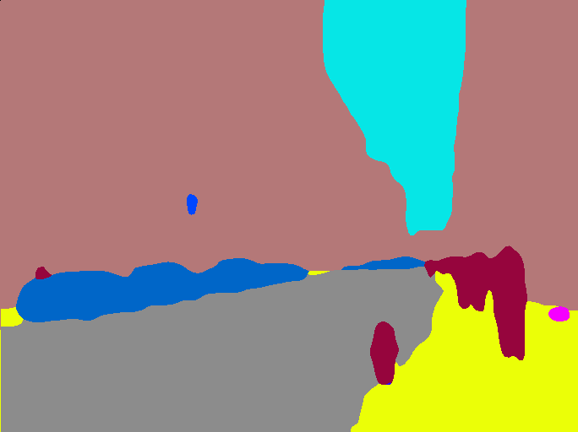


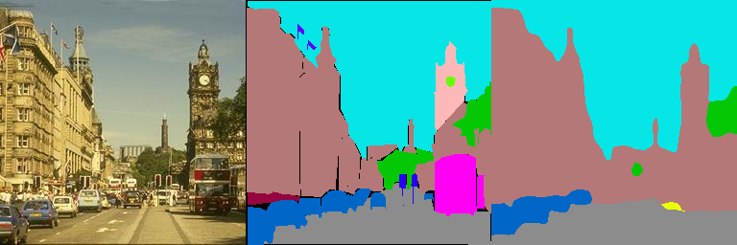
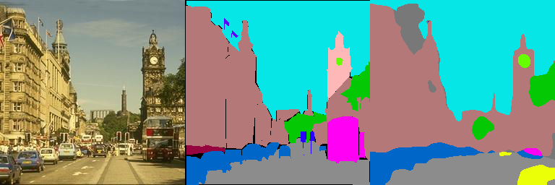
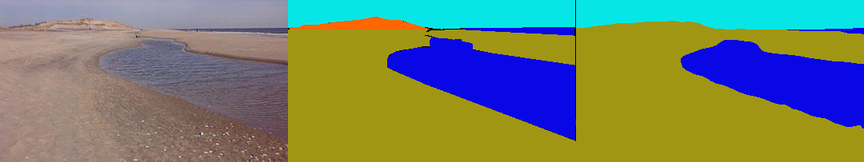
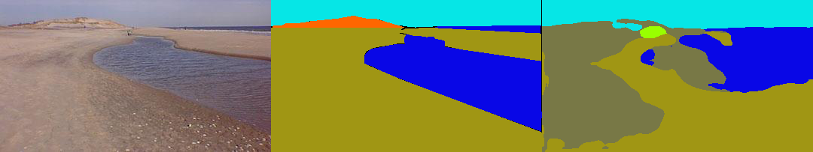
Image Ground Truth DANet PPM-DANet
PPM-DANet can capture more details in the images than DANet (circled in red).
PPM-DANet has worse performance in identifying the big objects and tend to predict more shattered structure (such as the last example).
However, as stated before, this can be due to the fact that the PPM-DANet is more complicated in parameters and is harder to train.
Notes:
But some evidence is found to show that the ppm-danet may work better. As these parts circles in red, PPM-DANet can capture more details in the images than DANet while maintaining a relative good semantic segmentation. However, PPM-DANet has worse performance in identifying the big objects and tend to predict more shattered structures, but this can be due to the fact that the model is not trained to the best.

